Slide 1
Information Extraction on the Web

Slide 2
Overview
What’s information extraction?
The contemporary IE systems
Future work

Slide 3
What’s information extraction
Goal: extract structured information from unstructured machine-readable documents.
IE on the web
Online extraction: fast, flexibility

Slide 4
The data source
Semi-structured data
——The most popular data on the web
Structured data (WI)
Free text (NLP)

Slide 5
Typical subtasks
Content Noise Removal
NER
Relationship Extraction
Coreference solution

Slide 6
Evaluation
Recall & Precision
MUC-7
ACE (Automatic Content Extraction) Evaluation
http://www.itl.nist.gov/iad/894.01/tests/ace/

Slide 7
IE Systems
NLP-based (WHISK, RAPIER, SRV)
Wrapper Induction (WIEN, SoftMealy, STALKER)
Modeling-based (NoDoSE, DEByE)
Ontology-based (BYU, X-tract)

Slide 8
WHISK
Strengths:
Support all kinds of data source
Use mixed technologies of NLP and delimiter-based approaches
Drawback:
Supervised system

Slide 9
IE products
Knowlesys
GATE
OpenCalais
ArtEquAKT

Slide 10
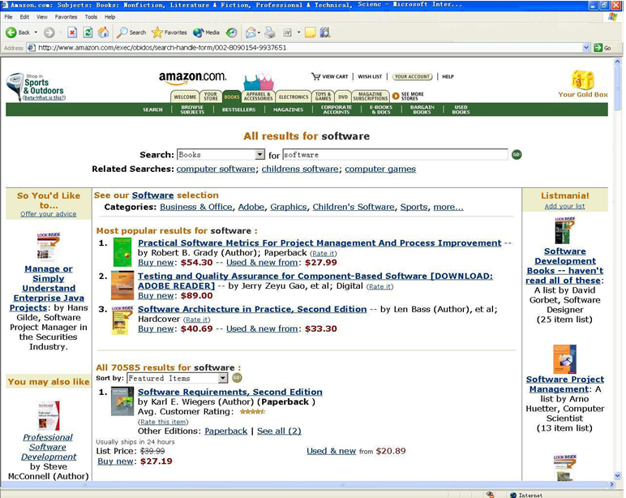
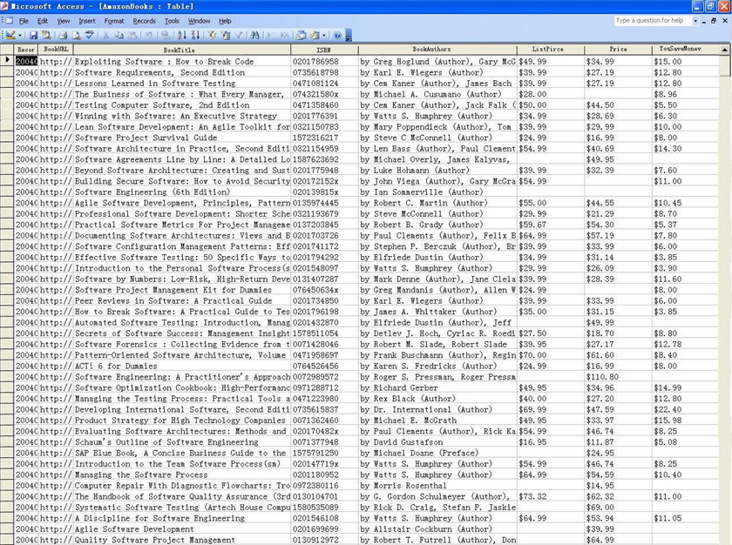
Knowlesys
Provide web page extraction services and convert the results to database format.
Homepage: http://www.knowlesys.com
Traits:
Based on page structure
Only summit your requirement, and wait for a DB result!
Weak point:
Source limited
Not free

Slide 11
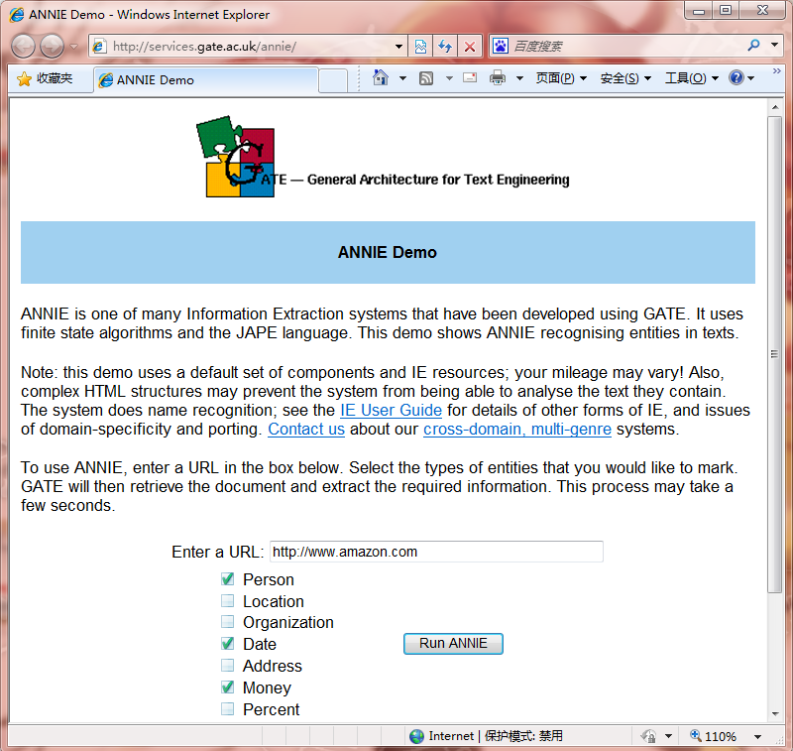
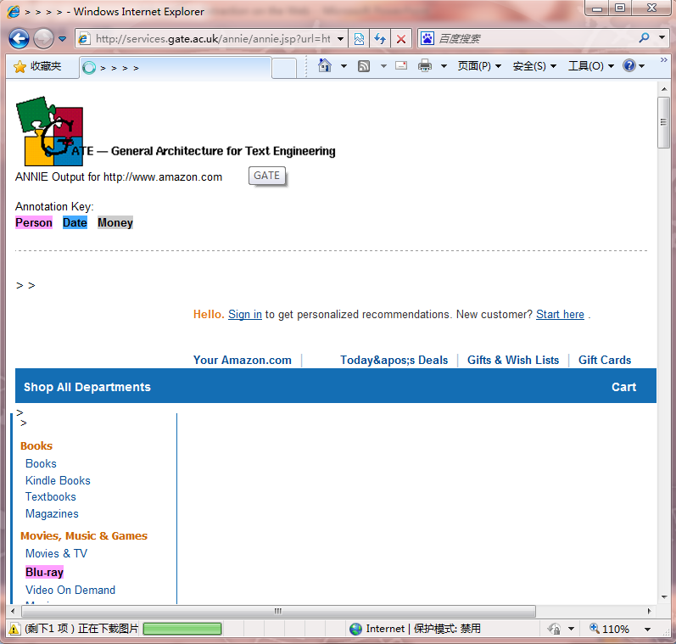


GATE
A text-analyzing tool which perform most of the language processing. One Web IE system based on GATE is ANNIE.
GATE: http://gate.ac.uk/
ANNIE: http://services.gate.ac.uk/annie/
Traits:
Just input a URL of the web page
Focus on entity recognition
Drawbacks:
The results are not always correct
No relationship extraction in ANNIE

Slide 12
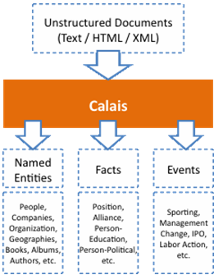
OpenCalais
Homepage: http://www.opencalais.com/
Traits:
Can find the hidden facts and
events
Results in RDF format
Drawbacks:
Not open source

Slide 13
ArtEquAKT
Homepage: http://www.aktors.org/technologies/artequakt/
Traits:
Builds on GATE
An Ontology-based IE system
Drawbacks:
Domain limited, only focus on art!

Slide 14
Future Work
Relationship extraction on the web is still a difficult task.
The data domain is still limited in high automatic extraction approaches.
Ontology and domain dependency

